Slide 1


ISDS 552 GP2
TEAM MEMBERS:
DEEPAM KHIRWAR
HARSHITA DIDWANIA
KAVINDU WALIMUNIGE
SANCHIT SINGH
SATHIYA PRIYA JEEVANANDAN

Slide 2
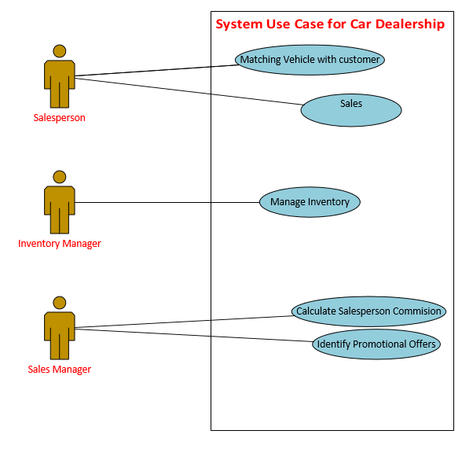
System Use Case Diagram for Car Dealership System

Slide 3
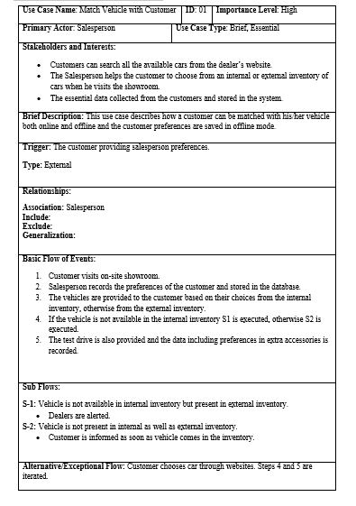
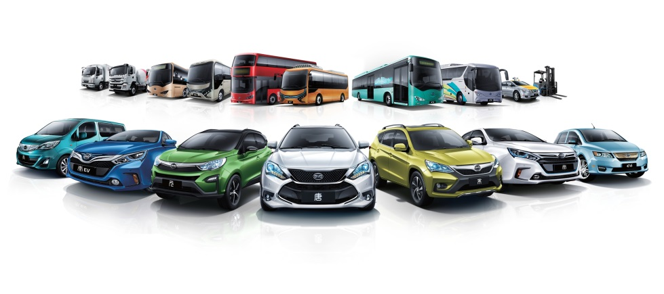
Matching Vehicle with Customers
Use Case

Slide 4
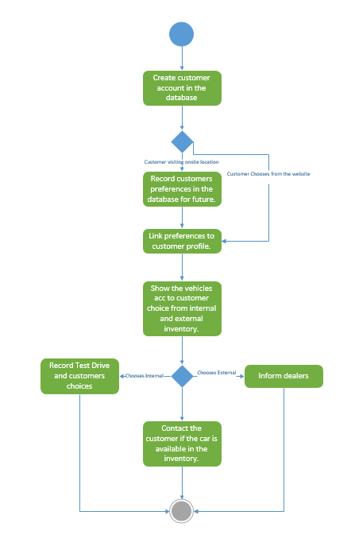
Matching Vehicle with Customers
Activity
Diagram

Slide 5

Sell Car
Use Case

Slide 6
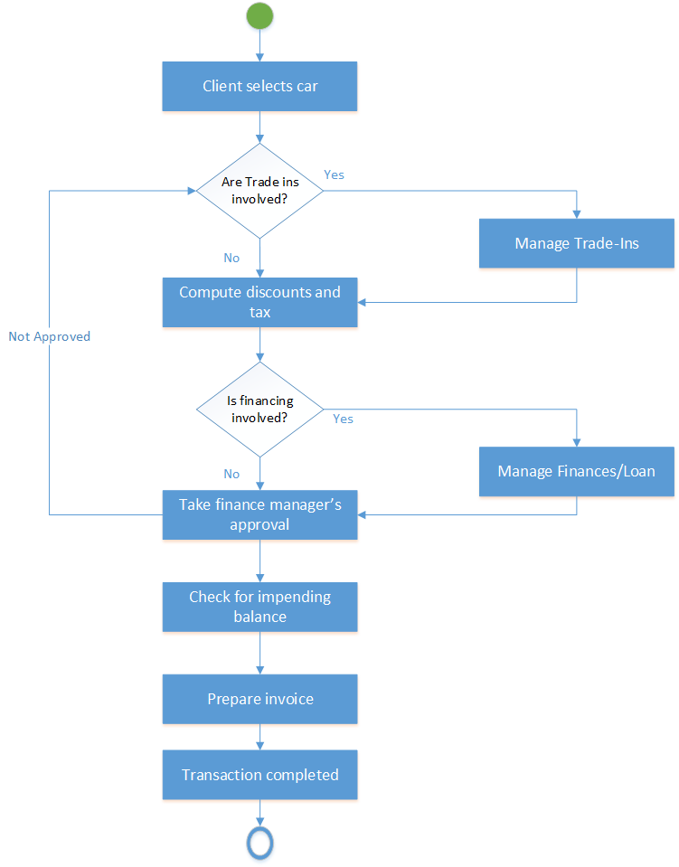
Sell Car
Activity Diagram

Slide 7
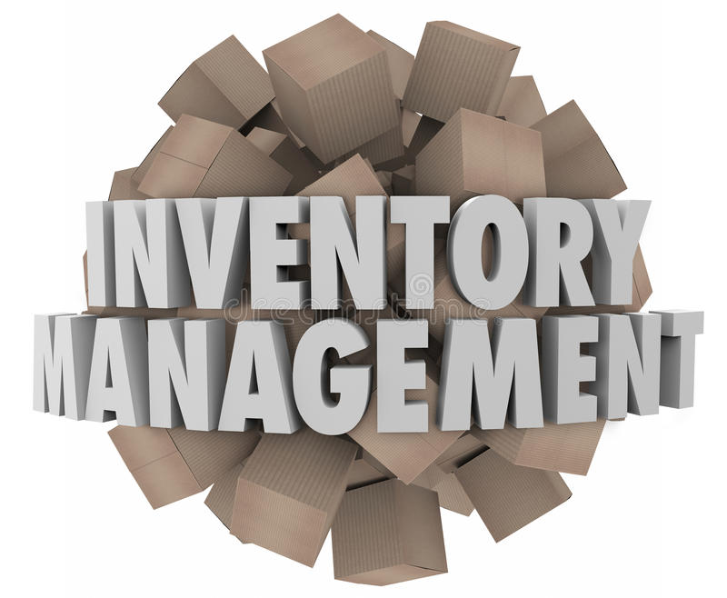
Inventory Management
Use Case Name: Inventory Management | ID: 3 | Importance level: High
Primary Actor: Inventory Manager | Use Case Type: Overview, Essential
Stakeholders and Interests: The inventory of the company is managed and controlled by the Inventory manager. The inventory manager reviews the orders from the customers and also updates the order accordingly. And, if required the inventory manager also places new orders to the manufacturers accordingly.
Brief Description: How the inventory is organized and managed in the company is described in this case.
Trigger: When a sale is initiated by a car dealership or new product is launched and if there is a requirement unavailability. Type: Internal
Relationships: Association: Inventory manager, Product Manufacturer, Sales Manager and Financial Manager. Include: The car requested by the customer which is not available in the stock. Extend: Generalization:
Normal Flow of Events: A sale is initiated by the car dealership, when a customer selects a car. Inventory manager raises a request to update the inventory. The inventory update request is approved by the Financial Manager. A new order is placed to the manufacturers by the Inventory Manager. The inventory stock is updated accordingly by the Inventory Manager.
Sub-flows: S1: If there is an unavailability of a car in the internal stock. A request is raised for the inventory by the Sales Manager as per the customer requirement. If there is unavailability of the product in the inventory, the Inventory Manager will raise a request for updating the inventory. S2: Customer selects a trade-in option. Once the trade-in is approved by the Inventory Manager, the vehicle is added to the internal inventory.
Alternative/Exceptional Flow: The Inventory Manager updates the inventory after the sale of the product.
Use Case

Slide 8
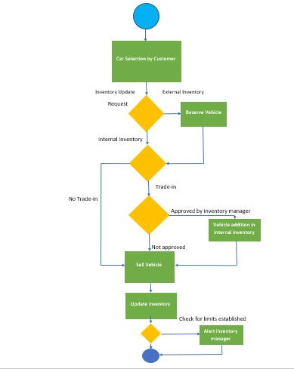
Inventory Management
Activity
Diagram

Slide 9
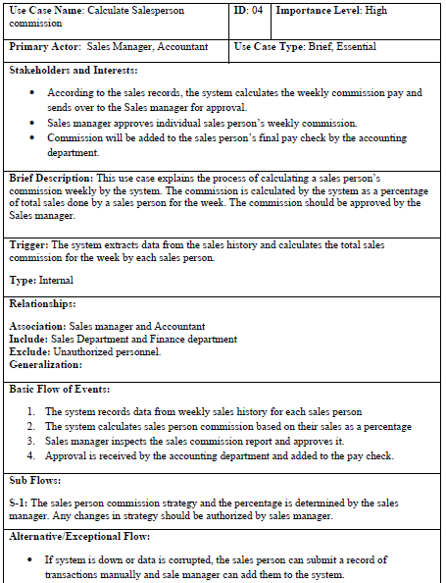
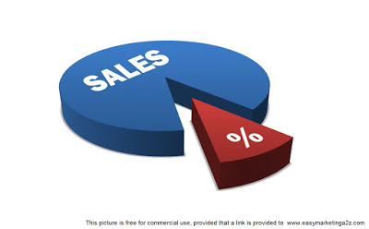
Calculate Sale person commission Use case

Slide 10
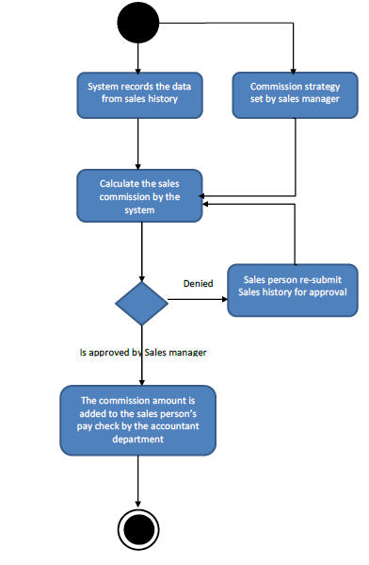
Calculate Sale person commission Activity Diagram

Slide 11
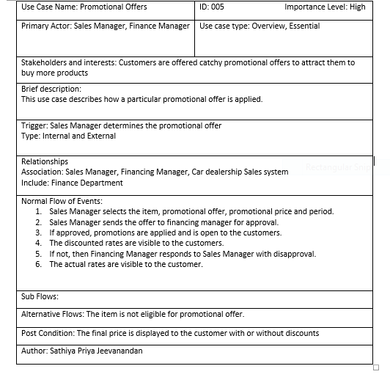

Promotional Offer
Use Case

Slide 12
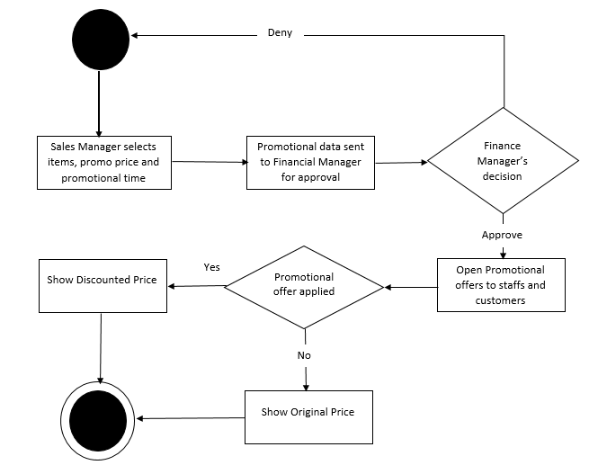
Promotional Offer
Activity
Diagram

Slide 13
Thank you!

